Slide 1
A PRESENTATION ON SEISMIC ANALYSIS AND DESIGN OF RCC FRAMED Commercial building
Prepare by:
Risihikesh Neupane (015-104)
Shashi Simkhda (015-114)
Sushil k. Chaudhary (015-122)
Advisor
Asst. Rajiv Manadhar
Department of Civil Engineering
Nepal Engineering College
Changunarayan, Bhaktapur, Nepal
August,2019

Slide 2
PRESENTATION OUTLINE
Introduction
Objectives
Scopes
Limitation
Methodology
Analysis
Detailing

Slide 3
INTRODUCTION
Seismic analysis and design of RCC framed residential/commercial building
Contains structural analysis, design and detailing of Commercial Business building
Earthquake prone zone (zone V, IS 1893:2002)

Slide 4
OBJECTIVES
To seismic analysis and design of RCC framed residential / Commercial building.
To learn the concept of lateral and vertical loading on the building.
To model the building for the structural analysis.
To perform detail structural analysis using ETABS.
To perform structural detailing of the members.

Slide 5
SCOPES
Identification of the building and the requirement of the space.
Preliminary design for geometry of structural elements.
Identification of load cases and load combination cases.
Finite element modeling of the building and input analysis

Slide 6
LIMITATIONS
Sanitary and electrical works are not considered.
Actual parameters of geotechnical data are not considered.
Lift and shear wall is not designed.

Slide 7
Codes used
1. Indian Standard (IS) Codes of Practice:
IS 1893 (Part 1): 2016 Criteria for Earthquake Resistant Design of Structures (General Provision and Building).It deals with dead loads.
IS:875- 1987 (Part 2)- Code of Practice for Design Loads (Other than Earthquake) for Buildings and Structures. It deals with imposed loads.
IS 456: 2000 :Plain and Reinforced Concrete – Code of Practice.
IS 13920: 2016 :Ductile Detailing of Reinforced Concrete Structures Subjected to Seismic Force- Code of Practice.
SP 16: Design Aids for Reinforced Concrete.

Slide 8
METHODOLOGY
Preparation of Architectural Drawing
Preliminary Design
Load Calculation
Modeling
No
Observation of Result
Is result with in codal limits?
Yes
Data Obstruction
Design

Slide 9
BUILDING DESCRIPTION
Building Type : Residential cum Business Building
Site location : Unknown
Structural System : Moment resisting RCC framed
Plinth area covered : 3455.04 square ft.
No. of Storey : 7
Type of Sub-Soil : Medium soil (bearing capacity 125N/mm2)
Type of beam : a) Numeric grid : 250*550 mm
b) Alphabetic grid :250*550 mm
c) secondary beam :250*450 mm
Type of column : Square column with size 550* 550 mm
Type of staircase : Open well staircase
Type of foundation : Raft foundation
Method of analysis : Seismic coefficient method
Design concept : Limit State Method

Slide 10
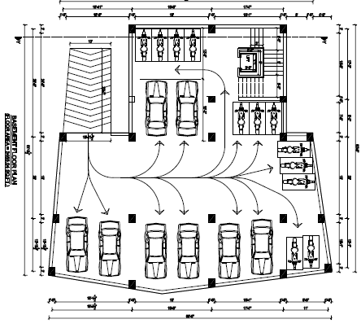
basement

Slide 11
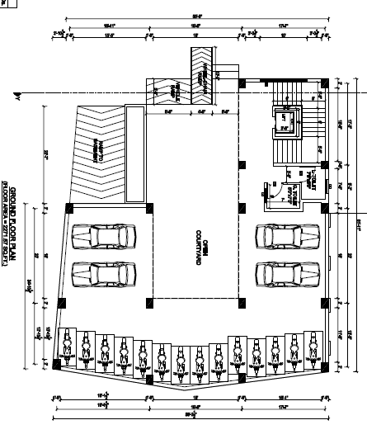
GROUND FLOOR

Slide 12
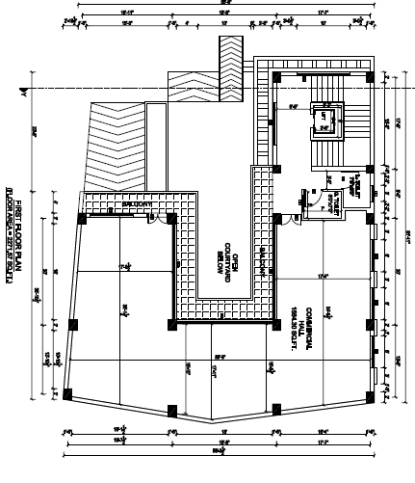
first floor

Slide 13
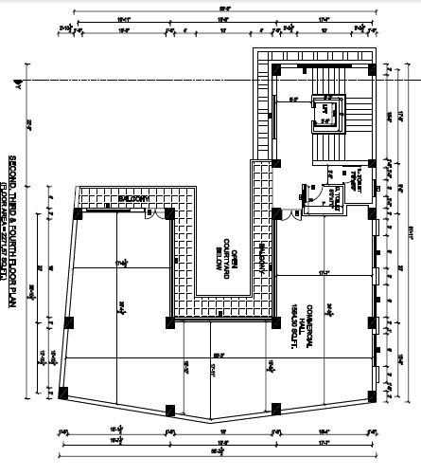
SECOND FLOOR

Slide 14
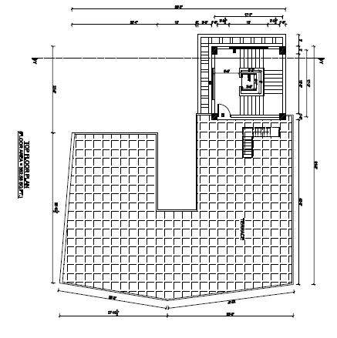
Roof floor

Slide 15
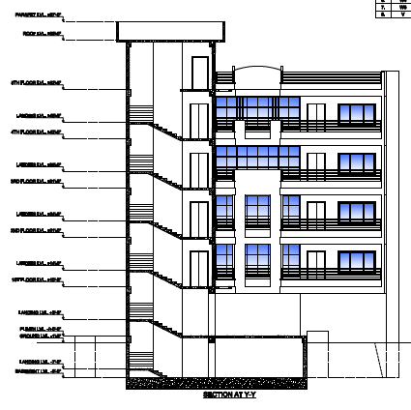
west elevation

Slide 16
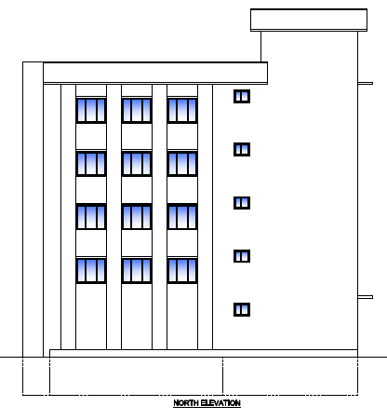
NORTH ELEVATION

Slide 17
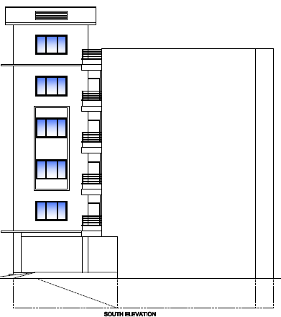
South elevation

Slide 18
PRELIMINARY DESIGN SLAB
Slab
Depth=L/ αβγδλ = 5981.7/(26*1.7); d =135.33mm
overall depth, D = 135.33+15+10/2
= 155.33mm> 150 mm
So provide secondary beam
Eff. depth of slab(d)=5.9817*10^3/(2*26*1.7) =67.67mm
Total depth(d)=67.67+10/2+15 =87.67mm
Provide(D)=125mm
For secondary beam
Effective depth (d) = l/20 =304.8mm
Provide Depth(D)= 450 mm
Width of secondary beam(b) = D/2 to 2D =450/2 =225 < 230 (ok)
Adopt (b) = (225 x 450) mm

Slide 19
Beam
i) For Alphabetic Grid:
.·. Depth (D) =l/12 = 5943.6/12 = 495mm
Overall depth (D) = 495+25+25/2 = 532.5mm
.·. Adopt depth (D) = 550mm
Width of beam = 1/2 of the depth= 550/2 = 225mm
Adopt, b = 225mm
Hence, size of beam = 225 mm * 550mm

Slide 20
ii) For Numerical Grid
.·. Depth (D) =l/12 = 6096/12 = 508mm
Overall depth (D) = 508+25+20/2 = 543mm
.·. Adopt depth (D) = 550mm
Width of beam=1/2 of the depth= 225mm
Adopt, b = 225mm
Hence, size of beam = 225 mm * 550mm

Slide 21
SEISMIC WEIGHT OR LUMPED MASS
Discription | Weights(KN) |  |  |  |  |  |  |  |  |  | Total
 | Wall | Parapet | Column | Beam | Sec.beam | Staircase | Slab | Lift | Live load | Floor finish
Roof floor | 90.229 | 129.997 | 37.8 | 66.17 | 0 | 0 | 105.264 | 28.448 | 0 | 33.6 | 491.632
Fifth floor | 503.114 | 122.031 | 205.2 | 373.32 | 136.2868 | 43.2 | 605.18 | 56.976 | 158.276 | 206.112 | 2205.079
Fourth floor | 801.708 | 44.526 | 334.8 | 373.32 | 136.868 | 80.325 | 605.18 | 56.976 | 158.276 | 206.112 | 2798.093
Third floor | 801.708 | 44.526 | 334.8 | 373.32 | 136.868 | 80.325 | 605.18 | 56.976 | 158.276 | 206.112 | 2798.093
Second floor | 801.708 | 44.526 | 334.8 | 373.32 | 136.868 | 80.325 | 605.18 | 56.976 | 158.276 | 206.112 | 2798.093
First floor | 801.708 | 0 | 334.8 | 334.8 | 136.886 | 80.325 | 605.18 | 56.976 | 158.276 | 206.112 | 2753.566
Ground floor | 711.586 | 0 | 386.1 | 486.786 | 188.413 | 80.325 | 948.794 | 56.976 | 240.041 | 0 | 3099.995
Total |  |  |  |  |  |  |  |  |  |  | 16944.5542

Slide 22
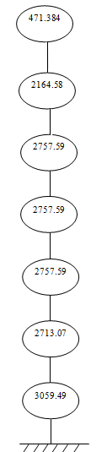
LUMP MASS DIAGRAM
Fig : lump mass diagram

Slide 23
BASE SHEAR
According to IS 1893 (Part I): 2002
Along X-axis Along Y-axis
T_{a x}= 0.459 sec T_{a y} = 0.439 sec
For medium soil type
Sa/g = 2.5 (for both x-axis and y-axis)
Ah= 0.108
VB = Ah x W
VB)x = (VB)y = 1830.0118KN
Base shear along both direction are same

Slide 24
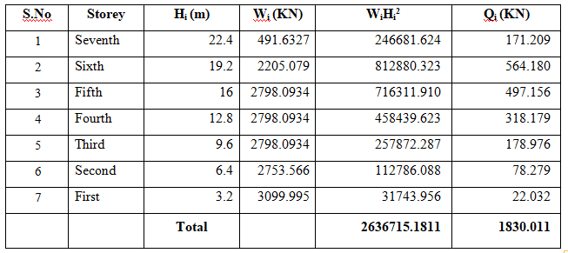
BASE SHEAR

Slide 25
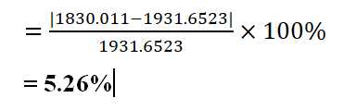
Comparison of base shears
By Manually,
Base shear =1830.011 KN
Through Etabs
Base shear =1931.6523 KN
percentage change in base shear:

Slide 26
BASE SHEAR DIAGRAM
164.598 KN
719.9 KN
1226.662 KN
1541.07 KN
1717.935 KN
1795.269 KN
1817,071 KN
Fig : Base Shear Diagram

Slide 27
STORY SHEAR DIAGRAM
171.209 KN
564.180KN
497.156 KN
318.179 KN
178.776 KN
78.279 KN
22.032KN
Fig : Storey Shear Diagram

Slide 28
SLAB
Design of Structural Elements:
Thickness of slab
Load calculation
Design moment
Calculation of depth
Calculation of steel
Check for shear
Check for deflection
Check for development length

Slide 29
RESULTS:
i) For two way slab
d=105 mm
Assuming dia. = 10mm and clear cover =15mm
D=125 mm
Reinforcement:
Along short span 10mm φ @ 200mm C/C
Along long span 10mm φ @ 200mm C/C

Slide 30
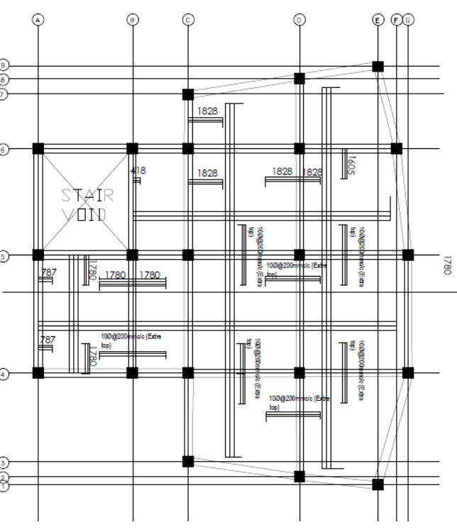
Reinforcement detail of slab

Slide 31
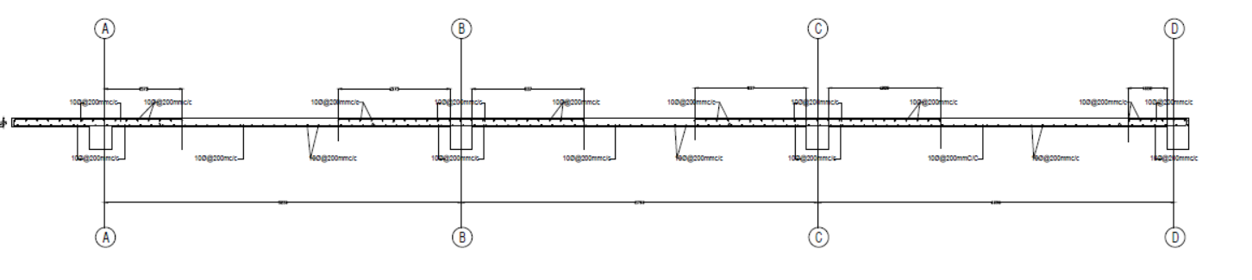
Slab section at x-x
10φ@200mm c/c
10φ@200mm c/c
10φ@200mm c/c

Slide 32
BEAM
Singly reinforced beam
M_{ulim,} =0.36*fck*b*Xu,lim*(d-0.46Xu,m)
IF M_{U} < M_{ulim,} then designed as singly reinforced beam

Slide 33
DESIGN OF BEAM
Ultimate moment of resistance
Deciding Singly or Doubly reinforced Beam
Calculation of quantity of steel
Check for minimum and maximum quantity of Steel
Check for shear
Check for development length
Calculation of shear reinforcement
Check for spacing

Slide 34
RESULTS:
D=550mm
B=300mm
Numbers of bars in tension and compression
At NEAR Support
Provide :
4-20mmφ bars as Top Reinforcement Bars
3-20mm φ bars as bottom reinforcement Bars
8mm φ 2 legged stirrups @ 200mm c/c.
At midspan
Provide:
2-20mm φ bars
8mm φ 2 legged stirrups @ 150mm c/c

Slide 35
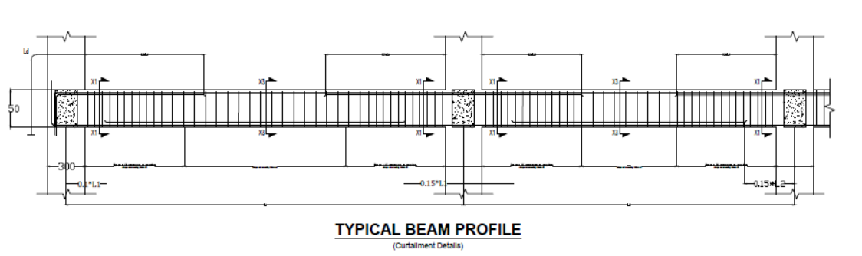
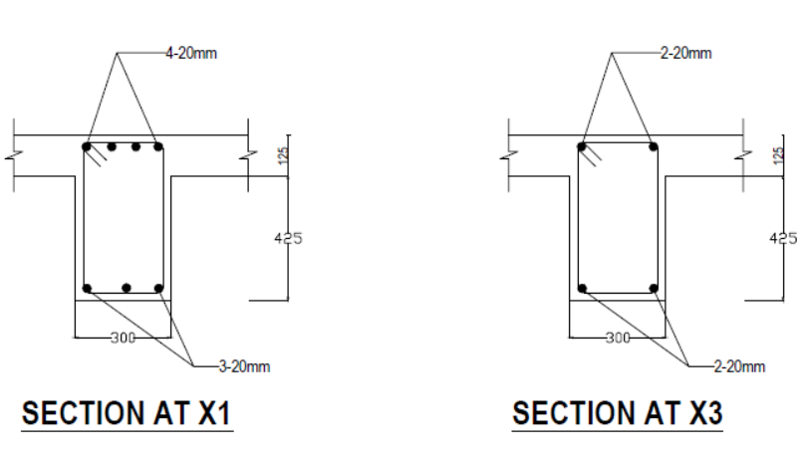

Slide 36

COLUMN
Check short/long column
Calculation of minimum eccentricity
Total axial load
Moment due to eccentricity
Find critical moment
Assume % of steel
d/ D & P_{u}/(f_{ck}*b*D ) & use SP-16

Slide 37
RESULTS
4-25mm ø bar
12-20mm ø bar
Adopt 8mm ø ties
Provide 8mm ø lateral ties @ 150mm c/c in central part.
From Ductile Consideration
Therefore provide lateral ties 8 mm dia@ 100 mm C/C up to 530 mm below and above the connection

Slide 38
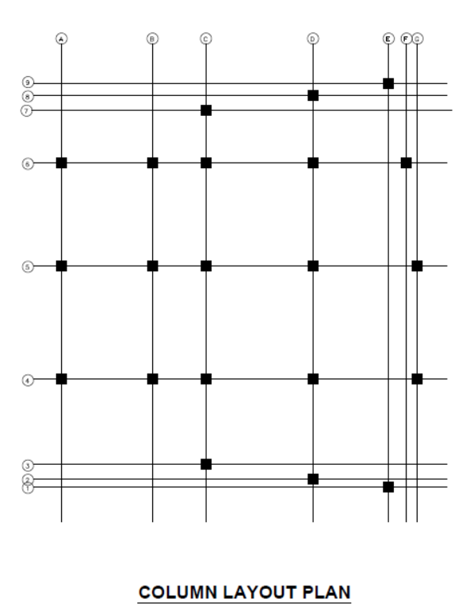
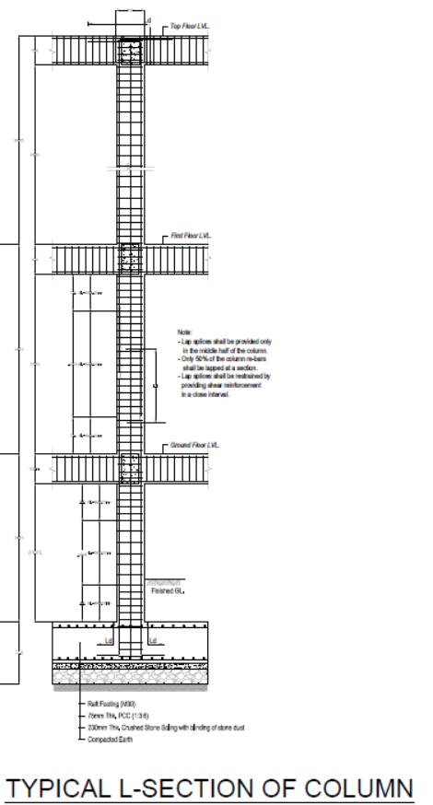

Slide 39
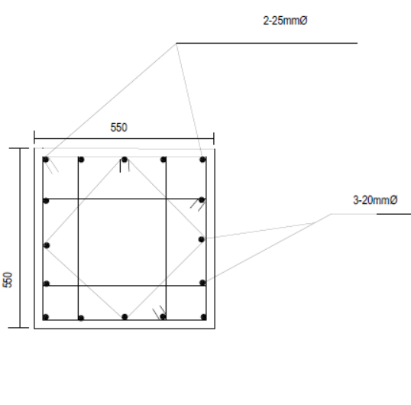
Column section

Slide 40
STAIRCASE
Open well Staircase
Geometry of Staircase
No. of Risers = 7 nos.
No. of tread = 6 nos.
Tread = 300mm
Riser = 190 mm
Effective Span of stair = 5400mm
Floor to floor height = 3200mm

Slide 41
STEPS
Assume thickness
Load and moment calculation
Calculation of depth
Calculation of steel
Check for development length

Slide 42
RESULTS
d=150 mm
D=175 mm
Provide 12 mm ϕ @ 150 mm c/c main bar
Provide 8 mm ϕ @ 150 mm c/c distribution bar

Slide 43
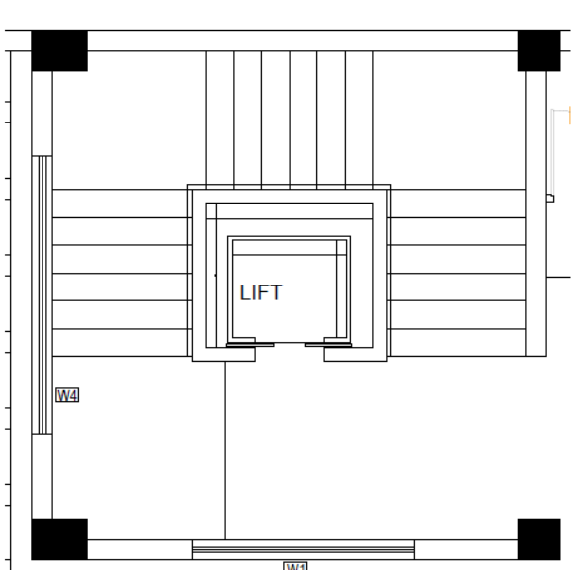
STAIRCASE PLAN

Slide 44
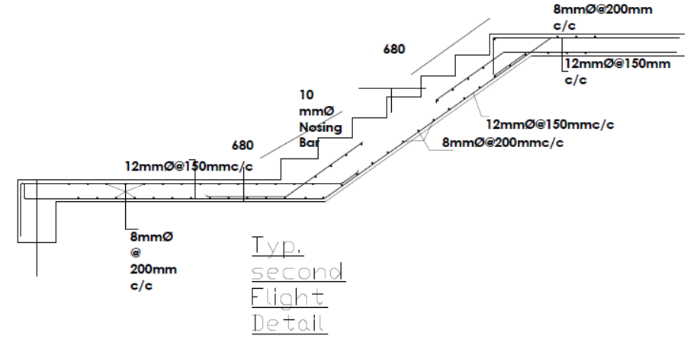
STRUCTURAL DETAIL OF STAIRCASE

Slide 45
FOUNDATION
Total vertical load = 23855.21KN
Safe Bearing Capacity of soil =125KN/m2
Area of footing required (A) = 23855.21/125
= 190.842m²
% of area covered by isolated footing = 59.455%
which is greater than 50%,so, raft foundation is used.
Overall depth (D) = 710 mm
Provide 16mm Ø bars @ 150mm c/c

Slide 46
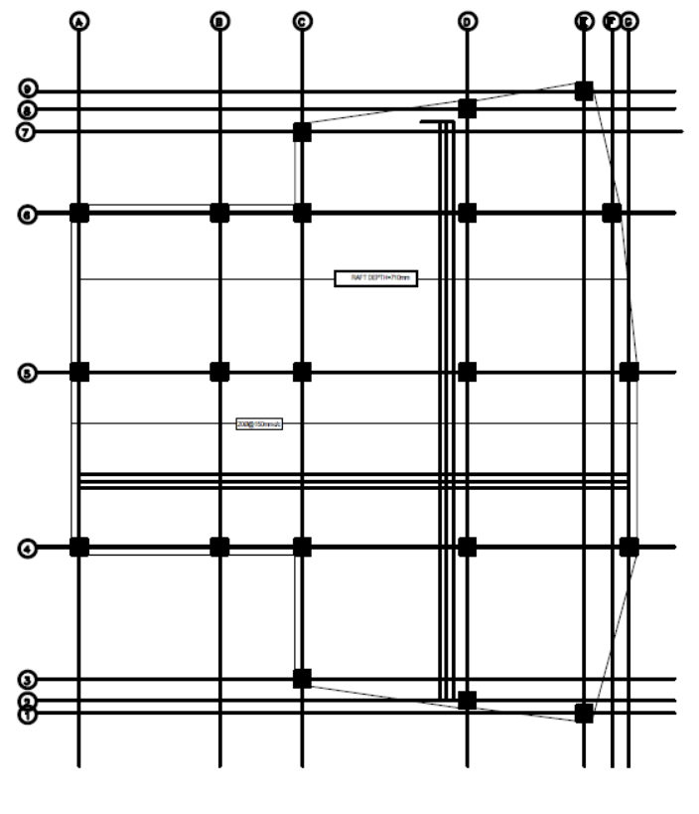
Raft foundation top bar layout

Slide 47
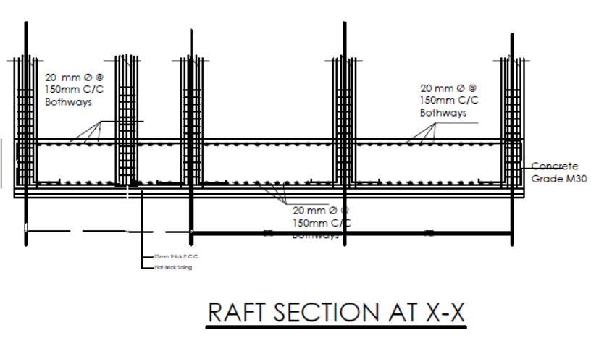

Slide 48
CONCLUSION
From the analysis and design of the five storied structure , we can conclude that the building can withstand substantial amount of earthquake force ensuring it to be safe at the moment earthquake strikes.
Design of similar type of frame structure can be done.
Good advising environment.

Slide 49
THANK YOU

